Slide 1
Distributed algorithms for multi-layer connected edge dominating sets
Dimitrios Papakostas, Soheil Eshghi, Dimitrios Katsaros, Leandros Tassiulas
¹Department of Electrical and Computer Engineering, University of Thessaly, Volos, Greece
¹Yale Institute for Network Science, New Haven, CT, USA

Slide 2
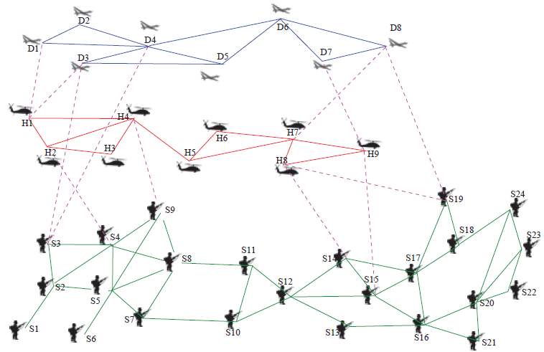
Motivation – multi-layer tactical networks
Drones
(Layer-1)
Inter-layer link
Helicopters
(Layer-2)
Intra-layer link
Soldiers
(Layer-3)

Slide 3
Link failure is a risk in deployed mobile networks
Drones
(Layer-1)
Helicopters
(Layer-2)
Soldiers
(Layer-3)

Slide 4
In hostile environments, nodes may be compromised
Drones
(Layer-1)
Inter-layer link
Helicopters
(Layer-2)
Intra-layer link
Soldiers
(Layer-3)

Slide 5
A backbone facilitates communication monitoring
Drones
(Layer-1)
Helicopters
(Layer-2)
Soldiers
(Layer-3)

Slide 6
A backbone should not rely on a single layer
Drones
(Layer-1)
Helicopters
(Layer-2)
Soldiers
(Layer-3)

Slide 7
We aim to create a network backbone that…
Can monitor all link failures
Can aggregate information (i.e., is connected)
Is small
Has many inter-layer edges
… in a distributed manner

Slide 8
We aim to create a network backbone that…
Can monitor all link failures
Can aggregate information (i.e., is connected)
Is small
Has many inter-layer edges
… in a distributed manner

Slide 9
Domination as a stand-in for monitoring

Slide 10
Dominating Set (DS)

Slide 11
Edge Dominating Set (EDS)

Slide 12
Independent Edge Dominating Set (IEDS)
a. k. a. maximal matching

Slide 13
Edge Dominating Set-based monitoring

Slide 14
We aim to create a network backbone that…
Can monitor all link failures
Can aggregate information (i.e., is connected)
Is small
Has many inter-layer edges
… in a distributed manner

Slide 15
Connected EDS for monitoring

Slide 16
We aim to create a network backbone that…
Can monitor all link failures
Can aggregate information (i.e., is connected)
Is small
Has many inter-layer edges
… in a distributed manner

Slide 17
CEDS design is complex
Minimum maximal matching (IEDS) is NP-Hard
|Minimum EDS| = |Minimum maximal matching| [1]
Every MMM is an MEDS, but not vice versa [1]
Minimum CEDS is also NP-Hard [2]
Finding a Minimum Multilayer Connected Edge Dominating Set is also NP-Hard.
So we look for empirically-efficient distributed heuristics

Slide 18
We aim to create a network backbone that…
Can monitor all link failures
Can aggregate information (i.e., is connected)
Is small
Has many inter-layer edges
… in a distributed manner

Slide 19
Distributed metrics for domination
Power Community Index (PCI) [3]:
PCI of a node $v$ is equal to $k$, such that:
there are $≤k$ 1-hop neighbors of $v$ with degree $≥k$
the rest of the 1-hop neighbors have degrees $≤k$
Cross-layer PCI (clPCI) was developed to incorporate layer-based connectivity and more general connectivity information in metric calculation [4].
We defined a similar metric for edges in multi-layer networks.

Slide 20
Distributed algorithms for creating CEDS
Complexity
MLEDS 1 |  | $$O(Δ^{3})$$
MLEDS 2 |  | $$O(Δ^{4})$$
MLEDS 3 |  | $$O(Δ^{4})$$
IEDS Creation
Connection
Pruning
IEDS Creation
Connection
Pruning #2 [5]
CDS Creation
Pruning
Edge Addition

Slide 21
Simulation Results
 | Average degree
 | 3 |  | 6 |  | 15
 | EDS Size (%) | % Intralayer | EDS Size (%) | % Intralayer | EDS Size (%) | % Intralayer
Baseline [6] | 58 | 39 | 42 | 25 | 15 | 18
MLEDS 1 | 54 | 66 | 34 | 61 | 11 | 25
MLEDS 2 | 34 | 45 | 23 | 51 | 11 | 47
MLEDS 3 | 29 | 42 | 21 | 53 | 11 | 49

Slide 22
Simulation Results
 | Average diameter
 | 3 |  | 8 |  | 17
 | EDS Size (%) | % Intralayer | EDS Size (%) | % Intralayer | EDS Size (%) | % Intralayer
Baseline [6] | 25 | 29 | 39 | 38 | 62 | 42
MLEDS 1 | 21 | 39 | 33 | 57 | 55 | 66
MLEDS 2 | 21 | 48 | 33 | 45 | 55 | 45
MLEDS 3 | 16 | 51 | 21 | 47 | 32 | 42

Slide 23
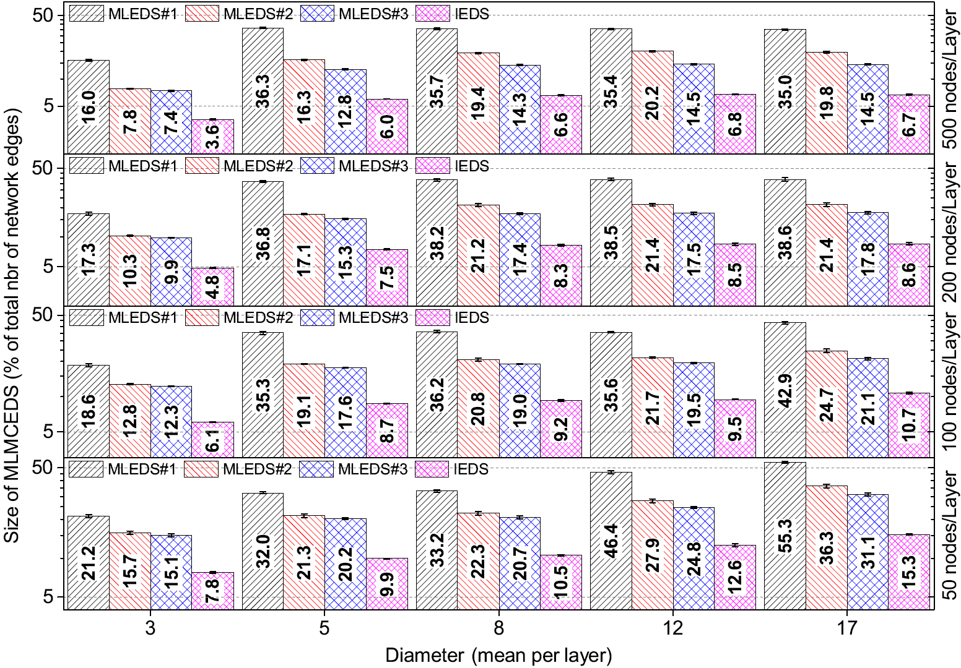
Simulation comparisons

Slide 24
Takeaways
Network monitoring in multilayer networks requires efficient selection of layer-diverse backbones
We created layer-aware distributed heuristics for evaluating the importance of edges in backbones
Starting with a CDS (rather than a CEDS) results in less redundancy in the distributed heuristics
Our distributed heuristics create small CEDS with a ~50-50 balance of intralayer and interlayer links in simulations

Slide 25
References
[1] M. Yannakakis and F. Gavril, “Edge dominating sets in graphs,” SIAM Journal of Applied Mathematics, vol. 38, no. 3, pp. 364–372, 1980.
[2] A. Munaro, “On some classical and new hypergraph invariants,” PhD Thesis, Université Grenoble Alpes, 2016.
[3] P. Basaras, D. Katsaros, and L. Tassiulas, “Detecting Capable Spreaders,” IEEE Computer Magazine, p.1, 2013.
[4] D. Papakostas, P. Basaras, D. Katsaros, and L. Tassiulas. “Backbone formation in military multi-layer ad hoc networks using complex network concepts,” MILCOM, pp. 842-848. 2016.
[5] D. Papakostas, S. Eshghi, D. Katsaros, and L. Tassiulas. “Energy-aware backbone formation in military multilayer ad hoc networks,” Ad Hoc Networks, vol. 81, no. 1, pp. 17-44, 2018.
[6] M. Gerla, J.-C. Tsai, “Multicluster, mobile, multimedia radio network,ACM/Springer Wireless Networks, vo. 1, pp. 255–265, 1995.

Slide 26
Questions?
Thank you for your time.
Soheil Eshghi
soheil.eshghi@yale.edu

Slide 27
Pruning methods

Slide 28
IEDS
1 Identification of 1-hop (N(u)) and 2-hop (N2(u)) neighborhood via
distributed beaconing and calculation of clPCI indexes of the nodes;
2 Build local edge adjacency matrix Emat
(u) with N(u) & N2(u);
/* 9 e(i;j) 2 E () i 2 N(j) ^ j 2 N(i) */
3 Add weights wedge
i;j = clPCI(i) clPCI(j) to Emat
(u) ;
4 Build Sedge
(u) = wedge
u;l1
, : : :, wedge
u;lm
j wedge
u;lk
2 E, lk 2 N(u) 8km;
5 if 9 wedge
u;lk (1km)
2 Sedge
(u) not attached to DS edge then
6 Select the edge with the largest weight and set M(u) = T;
7 M(wedge
u;lk (1km)) = T; /* EDS election */
8 Announce status change;
9 end
10 Collect all edges (across the network) with a status=T;
u, M(u) / M(wedge
i;j ) : True(T) / False(F) indicator for
node u / edge wedge
i;j being a DS node / edge.
1 Identification of 1-hop (N(u)) and 2-hop (N2(u)) neighborhood via
distributed beaconing and calculation of clPCI indexes of the nodes;
2 Build local edge adjacency matrix Emat
(u) with N(u) & N2(u);
/* 9 e(i;j) 2 E () i 2 N(j) ^ j 2 N(i) */
3 Add weights wedge
i;j = clPCI(i) clPCI(j) to Emat
(u) ;
4 Build Sedge
(u) = wedge
u;l1
, : : :, wedge
u;lm
j wedge
u;lk
2 E, lk 2 N(u) 8km;
5 if 9 wedge
u;lk (1km)
2 Sedge
(u) not attached to DS edge then
6 Select the edge with the largest weight and set M(u) = T;
7 M(wedge
u;lk (1km)) = T; /* EDS election */
8 Announce status change;
9 end
10 Collect all edges (across the network) with a status=T;

Slide 29
Relay selection methods
Gather 1-hop (N(u)) and 2-hop (N2(u)) neighborhood connectivity.
Calculate and broadcast clPCI§ index. Store the clPCI values of the N(u) neighbors.
Sort N(u) neighbors in decreasing order of their clPCI values.
Initially select as relays those N(u) neighbors that have already been selected as dominators by other neighboring nodes (if any)
While there are still nodes in N2(u) which are not neighbors to any node in the set of u’s relays, select and include in the set of u’s relays the next node from N(u) with the largest clPCI index that covers at least one new node in N2(u)

Slide 30
MLEDS 1
remarks : R(u) : relay node set of node u.
1 If M(u) = F then Return; /* not a DS node */
2 repeat
3 Add in R(u) a node l 2 N(u) with the largest clPCI
index that covers at least one new node in N2(u);
4 M(l) = T; M(wedge
u;l ) = T; /* CEDS process */
5 until each node in N2(u) is covered by node(s) in R(u)
6 Announce status change;
7 Build Sedge
(u) = wedge
u;l1 , : : : wedge
u;lm
j wedge
u;lk (1km) 2 E, lk 2
N(u), M(lk) = T;
8 Sort Sedge
(u) in increasing order of the wedge weights.
9 repeat
10 if wedge
u;lk (1km) is dominated by connected wedges 2
Emat
(u) with larger weight then
11 M(wedge
u;lk (1km))=F; /* EDS Pruning */
12 Announce status change;
13 end
14 until each wedge
u;lk (1km) 2 Sedge
(u) has been considered
15 Collect all edges (across the network) with a status=T;

Slide 31
MLEDS 3
Identification of 1-hop (N(u)) and 2-hop (N2(u))
neighborhood via distributed beaconing and calculation of
clPCI indexes of the nodes;
2 repeat
3 Add in R(u) a node l 2 N(u) with the largest clPCI
index that covers at least one new node in N2(u);
4 until each node in N2(u) is covered by node(s) in R(u)
5 Announce R(u);
6 if selected as a relay node then
7 M(u) = T; Announce status change;
8 Build Sconstrained
(u) = u1; u2; : : : ; un j uk (1kn) 2
N(u) ^ N2(u); M(uk (1kn)) = T,
clPCI(u) < clPCI(uk (1kn));
9 if Sconstrained is subject to
N(u) N(u1) [ N(u2)::: [ N(un) and
u1; u2; :::; un form a connected graph then
10 M(u) = F; Set M(wedge
i;j ) = F any edge wedge
i;j incident
to node u; /* CDS Pruning */
11 Announce status change; Return;
12 end
13 Build Sedge
(u) = wedge
u;l1 , wedge
u;l2 , : : : wedge
u;lm
j wedge
u;lk (1km)
2 E, lk 2 N(u), M(lk) = F;
14 if 9 wedge
u;lk (1km) 2 Sedge
(u) adjacent to a non DS edge
and that edge is not incident to a DS node then
15 M(wedge
u;lk (1km))=T; /* MCDS to MCEDS */
16 Announce status change;
17 end
18 end
19 Collect all edges (across the network) with a status=T;

