Slide 1

The Evolving Path of Scientometrics into the Science of Science
Yannis Manolopoulos
Open University of Cyprus
Sideris G., Katsaros D., Sidiropoulos A.
IDEAS’2018 Conference Calabria, Italy

Slide 2
Presentation outline
Introduction to Science of Science (SoS)
Relation of SoS to its precursors
Quantification of scientific significance
Predictions in science
Ranking based on multilayer networks
Conclusions

Slide 3

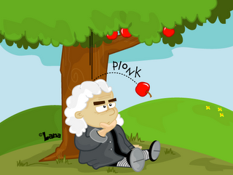
What is “Science”?
“A branch of study in which facts are observed and classified, and, usually, quantitative laws are formulated and verified: involves the application of mathematical reasoning and data analysis to natural phenomena”
Dictionary of Scientific and Technical Terms

Slide 4
What is “Science of Science (SoS)”
The field that seeks to:
  Understand, Quantify and Predict scientific research and the resulting outcomes
Major topics include:
  Measuring the influence of scientific publications, researchers, journals, and universities
  Modeling scientific collaboration and citation patterns
  Understanding innovation processes
  Classifying different scientific domains
  Predicting the future evolution of science

Slide 5
What enabled Science of Science?
First enabling factor: data availability provided
(freely many times) – by sources such as Scopus, Google Scholar, Web of Science, PubMed, Microsoft Academic, etc.
Scopus, by Elsevier with proprietary API with records from 1970
Web Of Science, created by ISI now operated by Clarivate Analytics
PubMed, free search engine of references and abstracts on life sciences

Slide 6
What enabled Science of Science?
Second enabling factor: the extensive collaboration of scientists, and the exchange and osmosis of ideas coming from many (seemingly) diverse disciplines, such as network science, scientometrics, sociology, …

Slide 7
Driving Force of Science of Science?
What actually drives the development of SoS is the industrialization of science in almost every aspects of it
  from scientific impact recording
  to research article reading/citing recommendation
  to hiring/promotion decisions, and
  to research fund allocation.

Slide 8
Presentation outline
Introduction to Science of Science (SoS)
Relation of SoS to its precursors
Quantification of scientific significance
Predictions in science
Ranking based on multilayer networks
Conclusions

Slide 9
SoS precursors: Complexity Science
Complexity Science: Studies the complex systems that consist of many entities and interact in
non-trivial ways, such that looking at the individual element behaviour cannot provide explanations for the behaviour of the whole system
Complexity Science is (erroneously) perceived as being the same as Network Science

Slide 10
SoS precursors: Network Science
Network Science: studies modern networks and their properties
Network science offered to SoS:
  network (growth) models: small world and scale-free
  centrality measures
  the study of diffusion processes such as
    influential spreaders, influence maximization
  Introduced novel network types, where the interacting entities are assumed to belong to more than one network, called layer.
    These networks are called multiplex, multisliced, multilevel, interdependent, or in general multilayer

Slide 11
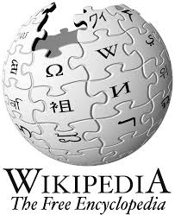
SoS precursors: Scientometrics
Scientometrics¹ : is the study of measuring and analyzing science, technology and innovation
Major research issues include:
    the measurement of impact (individuals, journals, institutes)
    understanding of scientific citations (e.g., laws: Lotka, Bradford)
    mapping scientific fields and the production of indicators for use in policy and management contexts
    reference sets of articles to investigate the impact of journals and institutes
¹Vassily V. Nalimov coined the term ‘scientometrics’ in the 1960s

Slide 12






Scientometrics: Major journals
Journal of the Association for Information Science and Technology
1950, Wiley
Journal of Informetrics
2007, Elsevier
Scientometrics
1978, Springer
Collnet Journal of Scientometrics and Information Management
2007, Taylor & Francis
International Journal of Bibliometrics in Business and Management
2017, Interscience
Research Evaluation
1991, Oxford Journals

Slide 13


Scientometrics: Major meetings
International Conference of the International Society for Scientometrics and Informetrics (ISSI)
International Conference on Webometrics, Informetrics, and Scientometrics (WIS)

Slide 14
What is SoS about, after all?
(Static) Data: scientific publication data, funding data, patent data, collaboration network data, citation network data
(Dynamics of) publications/citations/collaborations: preferential attachment growth, aging effect, sleeping beauties, team formation/assembly
Scientific significance: citation measures, centralities measures, scientist/journal/university/country ranking, credit allocation
Prediction in science: link prediction, impact prediction
Success in science: interdisciplinary research, funding,
Innovation and knowledge diffusion: patents, coauthorships, researchers mobility.

Slide 15
Presentation outline
Introduction to Science of Science (SoS)
Relation of SoS to its precursors
Quantification of scientific significance
Predictions in science
Ranking based on multilayer networks
Conclusions

Slide 16







Milestones in scientific quantification
1955
1997
2004
2005
2006
2014
  Eugene Garfield (1925-2017)
  Linguist
  Developed IF
  Founder of ISI
“Stand on the shoulders of giants”
Freely accessible Web search engine for scholarly literature
  Research Project- Structured API
  Compete with Scholar
Jorge E. Hirsch
Physicist
Develop h-index
Lee Giles; Kurt D. Bollacker; Steve Lawrence
Crawl and harvest papers on the Web
Focus mainly on CS
  Product level – customizable tool
  Bing + Cortana

Slide 17
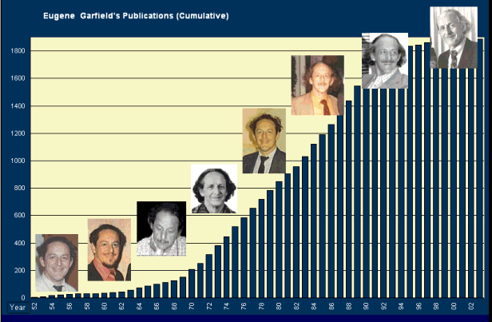
They all began …
on 1955 with the definition of the IF
  with the seminal article of Dr. Eugene Garfield about
  “Citation Indexes for Science: A New Dimension in Documentation through Association of Ideas”
  published by Science, 122, 108-111, 1955
Garfield founded the Institute for Scientific Information (ISI).
ISI formed a major part of the science division of Thomson Reuters company (now acquired by Clarivate Analytics) publishing every year the Journal Citation Reports (JCR)

Slide 18
The Impact Factor (IF)
IF definition
  The Impact Factor for each journal is the average number of citations acquired during the past two years for papers published over the same period
number of times articles published in JNL during
2016-2017 were cited in indexed journals during 2018
IF₂₀₁₈(of journal JNL) =
number of “citable” articles published by JNL in 2016 and 2017

Slide 19


Use and misuse of IF
1. As an objective measure of journal prestige. There are a vast number of journals to choose from, and the journals’ IF provides an objective measure of the overall quality of work published in that journal. As a general rule, the higher the IF value of a journal, the more prestigious it is considered to be.
2. To select journals for libraries. There are tens of thousands of journal publications in existence. The IF provides library administrators with a tool to decide which journals to retain in their collections and which new ones to acquire for their libraries.
3. Academic evaluation. The IF is often used in the process of academic evaluations of researchers for tenure, grants, funding, etc. However, this use is incorrect because the IF is only meant to indicate the quality of an entire journal, not the quality of individual articles published in the journal

Slide 20
Beware while using the IF
Few articles make the difference:
  Philip Campbell – Editor-in-Chief of the journal Nature – concerned about IF’s crudeness (ESEP, 2008):
    The value of Nature’s impact factor for 2004 was 32. When he analyzed the citations of individual Nature papers over the relevant period (i.e., citations in 2004 of papers published in 2002 to 2003), he found that 89% of the impact factor was generated by just 25% of the papers!

Slide 21
Beware while using the IF
When using the IF to compare or assess journals, beware for the following:
The absolute value of a journal’s IF is meaningless
For example, a journal with an IF of 2 would not be very impressive in
a subject like microbiology, but it would be in oceanography. Specialty journals - like disease-specific journals or journals focusing on disaster management - tend to have a low IF value because the journal articles are mostly read and cited by a small specialized audience
Disciplinary trends are different
Citation habits vary across different research areas. Therefore, IFs should not be used to compare journals across disciplines. For example, citation frequency is much higher in medicine than in mathematics
or engineering; therefore, medical journals have higher IFs than mathematical and engineering journals
21

Slide 22
Beware while using the IF
IFs are not very relevant in certain fields
For example, in computer science, conference proceedings are considered the principal form of scientific publication
Not having an IF doesn’t make a journal unworthy
Thomson Reuters calculates IFs based on their citation database. The database indexes roughly half of the approximately 25,000 peer-reviewed journals believed to be published. The coverage of their database is unevenly distributed as well, with some subject areas better indexed than others. In addition, although it indexes journals from 60 countries, there are not many publications from under-developed countries and only a small number of journals that publish in languages other than English
22

Slide 23
SNIP and CiteScore index by Scopus
Source Normalized Impact per Paper (SNIP)
  How its calculated: SNIP is computed so that citations are normalized by field. Thus, it eliminates variations found in IF wherein the IFs are high in certain fields and low in others
  Why it’s useful: SNIP is a much more reliable indicator than the IF for comparing journals among disciplines. It is also less open to manipulation by journals
CiteScore index
  Similar to IF, however has two differences:
  Considers the “items” published during the last three years (instead of the last two years considered by IF),
  Counts all documents as potentially citable, including editorials, letters to the editor, corrections and news items
23

Slide 24
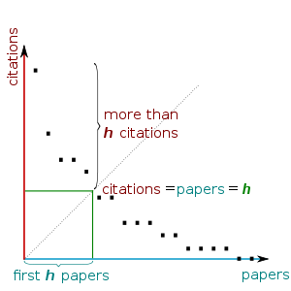
h-index: Accounting for impact and productivity

Slide 25
Parenthesis: Eddington number for cycling
Sir Arthur Stanley Eddington (1882-1944) was a British astronomer, physicist and mathematician. He was also a philosopher of science and a popularizer of science. He wrote a number of articles that announced and explained Einstein’s theory of general relativity to the English-speaking world.
The Eddington number for cycling is the maximum number E such that the cyclist has cycled E miles on E days. For example, an Eddington number of 70 implies that the cyclist has cycled at least 70 miles in a day on 70 occasions. Eddington's own E-number was 84.

Slide 26

h-index limitations
The h-index
  It can be manipulated through self-citations
  Does not account for the number and order of authors of a paper
  Does not account for the typical number of citations in different fields
  Does not account for the age of the scientist
    Time-aware extensions to h-index
      *Contemporary h-index (identifies young stars)
      *Trend h-index (identifies trend-setters)
*A.Sidiropoulos, D.Katsaros,Y.Manolopoulos, “Generalized Hirsch h-index for Disclosing Latent Facts in Citation Networks”, Scientometrics, vol. 72, no. 2, pp. 253-280, 2007

Slide 27
Perfectionism index
if (PI > 0) then perfectionist, else mass-producer
A.Sidiropoulos, D.Katsaros,Y.Manolopoulos, “Ranking and Identifying Influential Scientists vs. Mass Producers by the Perfectionism Index”, Scientometrics, Vol.103, No.1, pp.1-31, 2015.

Slide 28
Perfectionists and mass-producers

Slide 29
All indices have value: The skyline

Slide 30
Presentation outline
Introduction to Science of Science (SoS)
Relation of SoS to its precursors
Quantification of scientific significance
Predictions in science
Ranking based on multilayer networks
Conclusions

Slide 31
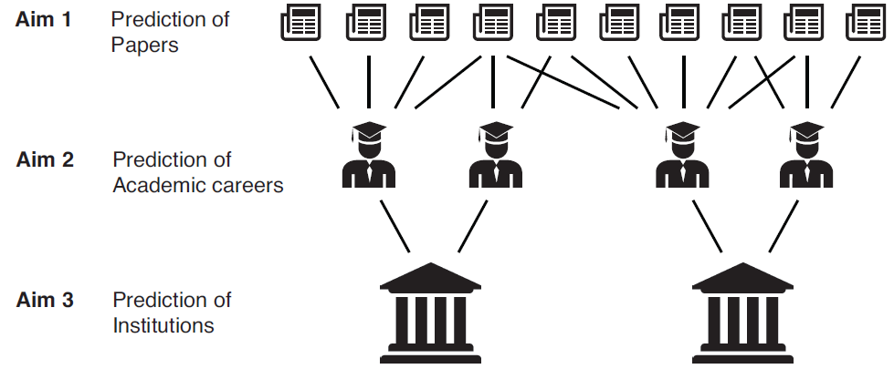
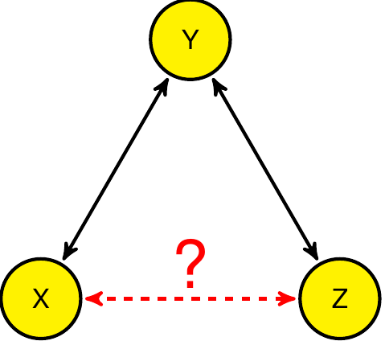
Predict what?
Forecasting future performance of an entity, either this is
a research article
or a scientist
Predicting future links in collaboration networks or identifying missing links in citation networks
31

Slide 32
Impact prediction: By regression
Regression: predict a numerical quantity, e.g. h-index or citation counts. Seminal work by Acuna et al.
Issues:
  Difficulty predicting highly skewed distributions
  “One-to-fit-model” cannot be adapted to various publishing patterns
  Need for fine-tuned, age and field adjusted models
Daniel Acuna, Stefano Allesina, Konrad Kording. “Future impact: Predicting scientific success”, Nature. 489, 2012.
Notes:
Acuna: generalized regression model with 5 coefficients, builds on Price. Limited to Neurobiologists. Time span 1-2-3 years.
Does not generalize to other fields, larger time spans

Slide 33
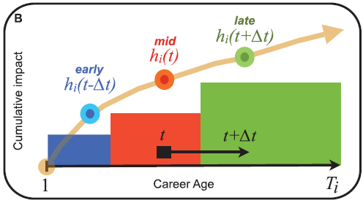
Target variable
h-index is a popular quantity to be predicted
  More stable than citation counts, limited range and non decreasing values

Slide 34
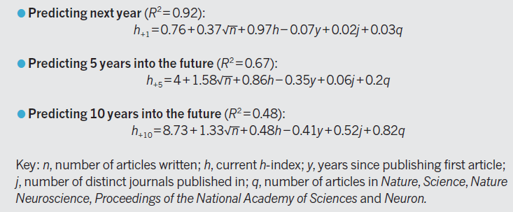
Predicting future h-index
Daniel Acuna, Stefano Allesina, Konrad Kording. “Future impact: Predicting scientific success”, Nature. 489, 2012.
34

Slide 35
Impact prediction: by modeling
Statistical Modeling: fit bibliometric quantities to complex distributions to approximate their evolution mechanism. Random Impact rule (Sinatra et al.)
Issues:
  Abundance of data required to calculate statistical parameters (e.g. exponent)
  Highly complex models when moving from publication level to author or institutional level
Notes:
Interpretable model but needs high volume of data to calculate plus the need to use many parameters

Slide 36
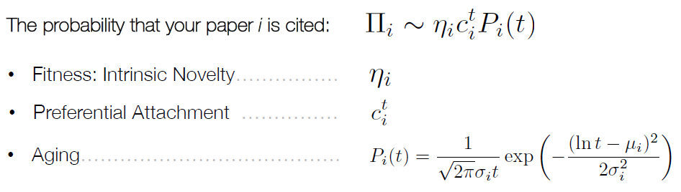
Prediction via modeling citation dynamics
R. Sinatra, D. Wang, P. Deville, C. Song, and A. L. Barabasi. “Quantifying the evolution of individual scientific impact”. Science, 354(6312), 2016.
36

Slide 37
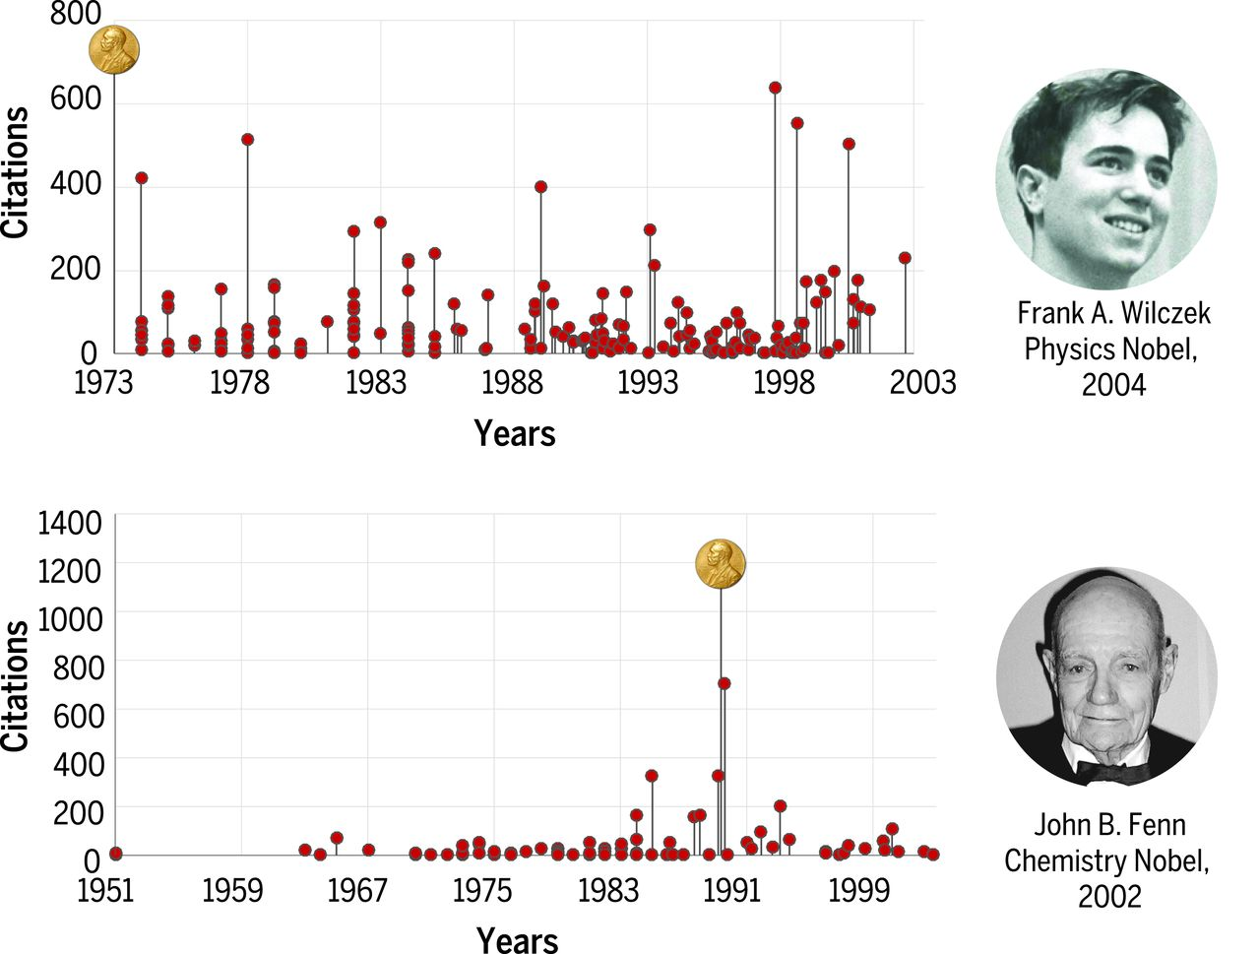
Impact Prediction : Random Impact Rule

Slide 38
Link prediction
The essence of any link prediction problem is the identification of similar not yet connected nodes
Popular techniques
  Number of common neighbors among the two examined nodes
  Jaccard coefficient of the sets of neighbors of the two examined nodes
  Katz index which calculates nodes similarity via paths counting
Notes:
Interpretable model but needs high volume of data to calculate plus the need to use many parameters

Slide 39
Presentation outline
Introduction to Science of Science (SoS)
Relation of SoS to its precursors
Quantification of scientific significance
Predictions in science
Ranking based on multilayer networks
Conclusions

Slide 40
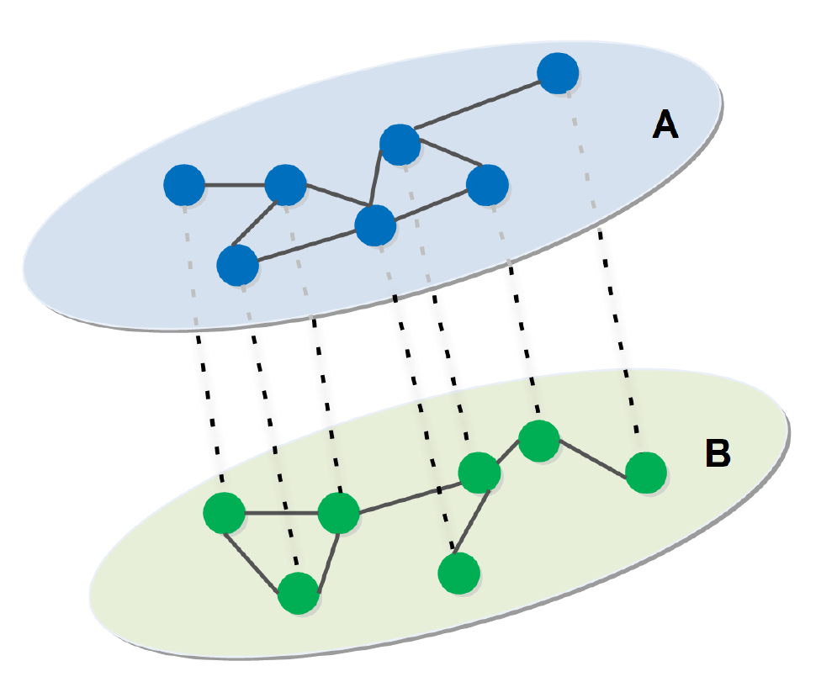
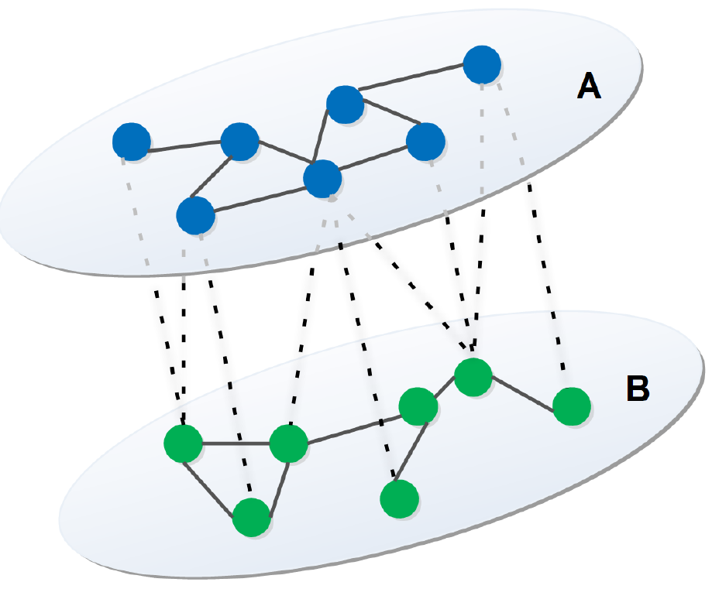
Multilayer and multiplex networks
Multiplex Network
Multilayer Network

Slide 41
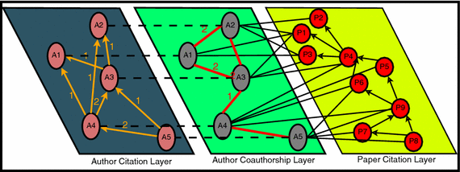
The C³-index
C³-index ranks authors based on
their received citations, and
their collaboration profile (via a PageRank strategy)
  ACI – Author citation Index
  PCI – Paper citation Index
  AAI – Author coAuthorship Index
D. Pradhan, P. S. Paul, U. Maheswari, S. Nandi, and T. Chakraborty. “C³-index: A PageRank based multi-faceted metric for authors’ performance measurement”. Scientometrics, 110(1):253–273, 2017.

Slide 42
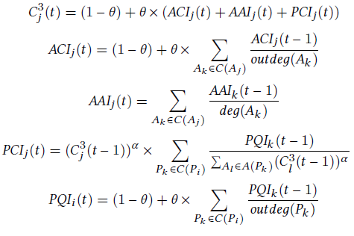
The C³-index
ACI – Author citation Index
PCI – Paper citation Index
AAI – Author coAuthorship Index

Slide 43
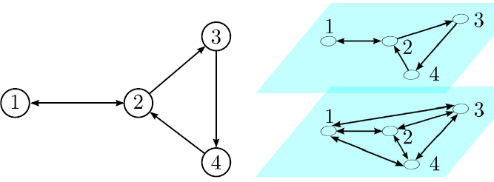
The Biplex PageRank
An extension of classic PageRank for multiplex networks
  Associates with each layer l_{i} two random walkers
    one for the physical layer (with topology given by l_{i})
    one for the teleportation layer
  Allows for transition between teleportation layers of different real layers and between physical layers
Francisco Pedroche, Miguel Romance, Regino Criado. “A biplex approach to PageRank centrality: From classic to multiplex networks”, Chaos, 26, 065301, 2016.

Slide 44
The C⁴-index
C⁴-index includes the following layers:
ACI – Author citation Index
PCI – Paper citation Index
AAI – Author coAuthorship Index
NBP – Author Centrality Index (Normalised Biplex PageRank)
The steps of C⁴-index are the following:
Calculation of the ACI, PCI , AAI for every author in the dataset (as done by C³-index).
Computation of Biplex PageRank
Normalization of Biplex PageRank results
Computation of C⁴j (t) as:

Slide 45
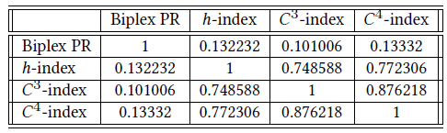
Preliminary comparison of indices
Biplex PageRank is uncorrelated to h-index, to C³-index and to C⁴-index
C⁴-index is highly correlated to C³-index, however …

Slide 46
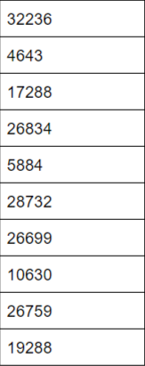
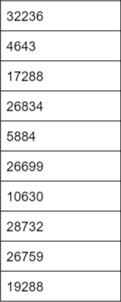
C⁴-index versus C³-index
C⁴-index ranking
C³-index ranking
…rank differences in even the top-10 lists (of author IDs)

Slide 47
Presentation outline
Introduction to Science of Science (SoS)
Relation of SoS to its precursors
Quantification of scientific significance
Predictions in science
Ranking based on multilayer networks
Conclusions

Slide 48
Conclusions
Science of Science: the study of big scholarly data from the perspective of complex systems
  Classic issues: evaluating papers/scientists
  New issues: understanding and modeling structural and dynamical patterns, predicting the evolution of a system
Complexity science plays a unique role in providing new insights
Major topics in SoS: Ranking, prediction, disclosure of hidden causality
Novel tools in SoS: multilayer networks, tensor analysis

Slide 49
Thank you!
Q & A

