Slide 1
A Scientist’s Impact over Time: The Predictive Power of Clustering with Peers
Antonia Gogoglou
Department of Informatics
Aristotle University of Thessaloniki
Antonis Sidiropoulos
Department of Information Technology, Alexander Technological Institute of
Thessaloniki
Dimitris Katsaros
Department of Electrical Engineering and Computer Engineering, University of Thessaly
Yannis Manolopoulos
Department of Informatics
Aristotle University of Thessaloniki

Slide 2
Scientometrics: a plethora of metrics- Open Issues
More than 100 indices exist to evaluate scientific work at author, publication or journal level.
A large pool of data is available online(Google Scholar, Microsoft Academic Search, Scopus, Web of Science, etc.).
Two important questions have yet to be answered:
“How does the career of a scientist in terms of his/her impact on the community progress over time?”
“Are there early signs of scientific potential?”
Notes:
Scientometrics: the study of bibliometric data in an effort to evaluate and quantify scientific impact.
Most popular indexes include: h-index, e-index, hI, hnor, PI, f index, etc. Different features of scientific performance.
Time and prediction two new important elements.

Slide 3
Our goals:
Apply a macroscopic approach to identify patterns in scientific output evolution and observe early signs of academic potential.
Introduce the problem of consistently grouping together peers over time and maintain a fair comparison basis.
Develop a methodology for quantifying and visualizing individual scientists’ evolution.
Compare proposed methods with peer-review to assess effectiveness.
Notes:
Peers include the ones with similar academic age and belonging to the same field. The true impact of a scientist can be revealed only when compared with peers
Different absolute values for the various indexes that vary across field and age.
State of the art includes microscopic approaches focusing on a particular index and its distinguishing properties and grouping of scientists/publications with similar distributions or similar citation counts.
Comparing the element of time and an appropriate choice of indexes based on dimensionality reduction can offer an approach applicable across all disciplines without a priori assumptions about the distribution of citations or knowledge of field particularities.

Slide 4
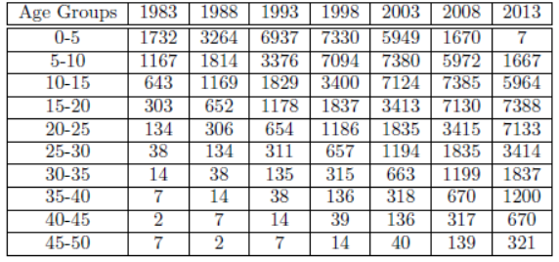
Data set description:
Full citation records retrieved from MAS for 30000 scientists of the Computer Science field with over 9 million papers and 38 million citations. In this dataset we have identified 22 SIGMOD award winners and 62 Turing award winners.
Table 1: Cardinality of datasets.
Notes:
Field categorization according to MAS
Filter of h index>8 based on the h-index categorized by MAS
10 age groups (academic age-years since first publication) and 7 years (with a 5 year time step). An author belonging to one age group in year 1983 will have moved to the next age group in the next contemplated year (1988)
High diversity in the cardinality of the datasets-> indicates that finding a unified clustering approach for comparisons across groups and time will be a challenge

Slide 5
Challenges: the appropriate clustering algorithm
Feature selection: h-index, PI/papers and total citations (C).
Diverse datasets to be assigned to clusters automatically ranked to allow temporal comparisons.
Dynamic clustering algorithms (DBSCAN, Learning Vector Quantization, etc.) provide different optimal number of clusters for each dataset.
We have adapted a Self-Organizing Map (SOM) approach to produce a specified number of clusters for each “snapshot”.
Notes:
In a previous work, we have grouped 40 bibliometric indexes and categorized them in 3 groups using PCA based on the different information they convey about publishing patterns and scientific impact. Choosing 3 indexes (one from each of the 3 groups) based on the different dimensions they occupied in the PC space.
Example for different number of clusters and how it would be problematic.

Slide 6
Challenges: the appropriate number of clusters
Two-phase approach:
For each feature and each distinct cluster sumMin, sumMean and sumMax are calculated and used to rank the clusters based on quality of members.
For different numbers of clusters we evaluated the silhouette, “precision” and “recall” and opted for 4 clusters to achieve better performance as well as meaningful segmentation.
Notes:
Highest ranking cluster (cluster representing the highest scientific impact) is the cluster with the highest score in the equally weighted sum: 0.33*sumMin+0.33*sumMean+0.33*sumMax
Silhouette expresses how good a segmentation we have achieved based on inter-and intra-cluster similarity.
Also we need a meaningful segmentation
precision: the fraction of the scientists that have received awards to the total number of scientists that have an average cluster membership classified as high
recall: the fraction of the scientists that achieved a high average cluster membership out of the ones that have been awarded

Slide 7
Scores for different cluster numbers
Table 2: Scores for the three evaluation metrics.
Notes:
We opted to test for relatively small cluster numbers, since to reflect performance a larger number of clusters would cause ambiguity.
Relatively low values of precision and recall, as our approach is not a supervised learning task and the aim was not to simply predict award winners but to create a unified framework for identifying influential scientists at any age and field. The award winning data sets are used as a compass towards choosing the most appropriate methodology.
4 is the optimal number of clusters since it achieves the highest recall and also a very high precision, without sacrificing silhouette.

Slide 8
Clustering result visualization:
Cluster 1(high impact): red
Cluster 2(moderate-high impact): green
Cluster 3(moderate-low impact): blue
Cluster 4(low impact): cyan
Figure 1: Authors with academic age 15-20 years
in the year 2013 clustered in 4 groups projected
on the Principal Component space.
Notes:
The scientists’ membership to a cluster is plotted in the Principal Component space of the 3 clustering features for further evaluation.
Authors to the far right (depicted with red) are the ones with the combination of the highest values in all three features.
This plot allows for an assessment of the consistency of the clusters and the degree of separation between the 3 clustering features, which are plotted as vectors in the principal component coordinate system. As can be seen, the PI index and the h-index are uncorrelated with each other, whereas the citation count C is connected to both features.
The first Principal Component mostly focuses on citation count, whereas the second Principal Component expresses the publication count.
The top cluster displayed to the far right of the figures includes the scientists with high citation count and small increase in publication count.

Slide 9
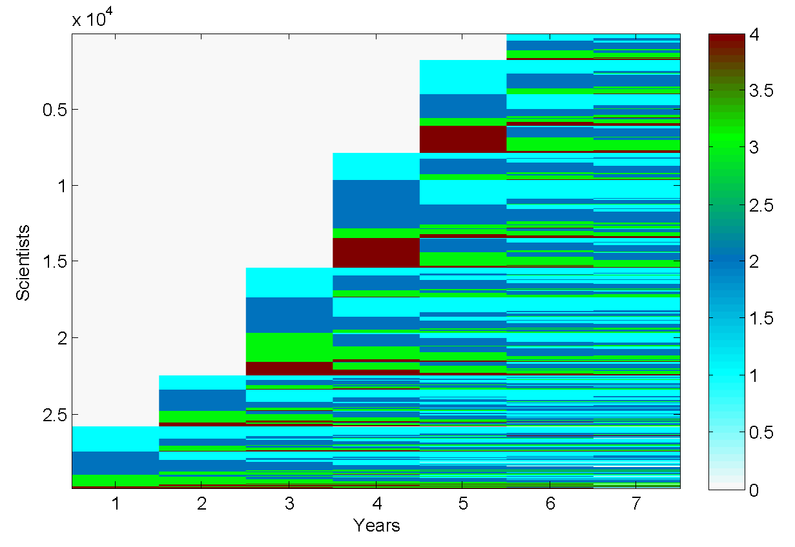
Time evolution of clusters (1):
Figure 2: Cluster membership of all authors in
the set since they first appear in a cluster.
Notes:
Each value on the y axis represents a specific scientist and different colors depict the cluster membership in the year indicated by the x axis value.
Many scientists start from the first two clusters and then either remain on that impact level or progress to higher impact clusters.
However, there is also a group of scientists with declining impact as time progresses
A small percentage of scientists are classified as high impact ones from the beginning of their academic career.

Slide 10
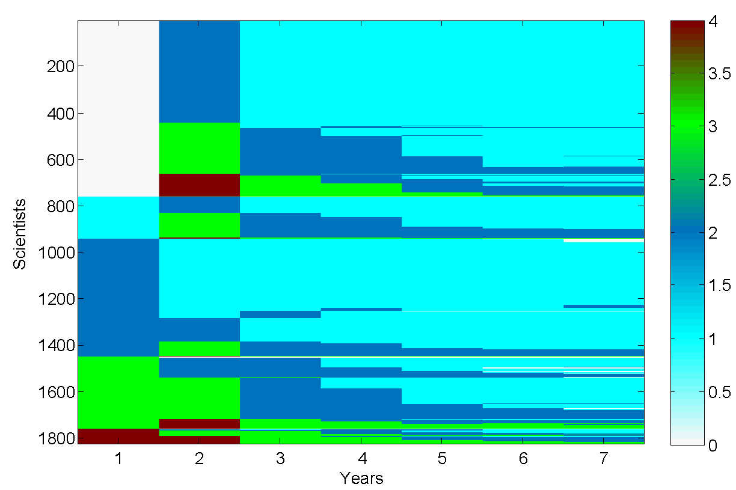
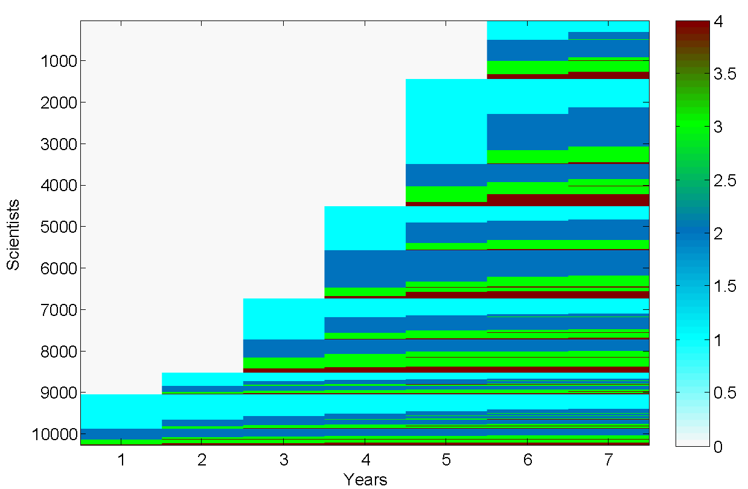
Time evolution of clusters (2):
Figure 3: Cluster membership of authors who have been clustered more than 4 times in a lower impact cluster than the best cluster membership they have ever scored.
Figure 4: Cluster membership of scientists that managed to progressively increase their score in all 3 bibliometric indices (C, h, PI) thus improving their cluster memberships.
Notes:
More detailed view on those scientists that increase their status over time and the ones that end up in lower impact clusters as time passes.
This decline is mostly captured by the Perfectionism Index that becomes smaller with the addition of new low or zero cited papers. Moreover, as a scientist’s cademic age increases gradually he/she are being compared with a different set of more mature scientists, and if they fail to analogously raise the quality of their research, they end up in a lower impact cluster.

Slide 11
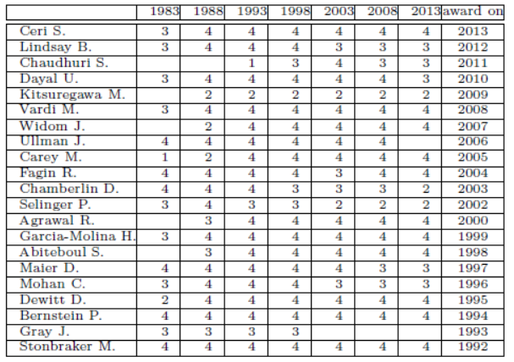
Comparison with award winners (1):
Almost all of the awarded scientists have been clustered to the high impact cluster (cluster 4) from the beginning of their career.
Their scores according to the 3 bibliometric indexes may not be significantly high as absolute values (cumulative nature of indexes), but can prove distinguishing compared to the analogous ones of their academic peers.
Table 3: Cluster membership for scientists that have won the ACM SIGMOD’s E.F. Codd
award.
Notes:
It can be observed that award winning scientists showed early potential.
Indicates the validity of our approach
Exceptions to this strong pattern can be seen in the cases of J. Gray, S. Chaudhuri who have an ‘industrial’ rather than ‘academic’ profile.

Slide 12
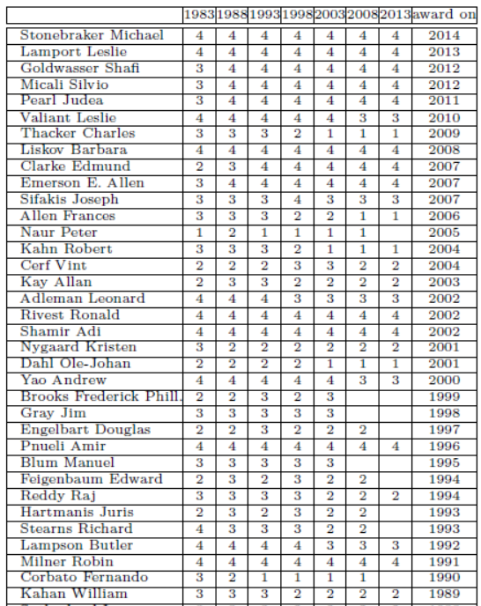
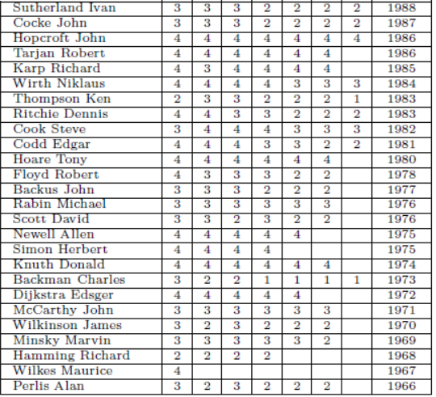
Comparison with award winners (2):
Table 4: Cluster membership for scientists that have won the Turing award.
Notes:
We can observe that less scientists being constantly grouped in cluster 4 appears more often. This is mainly due to the fact that our data cover a specified period of time, while a number of Turing Award winners have reached their academic peak before that time.
Also different awards may be driven by different motives and focus on particular features of scientific output.

Slide 13
Conclusions:
A unified framework that incorporates combination of features and the time parameter as well as the concept of peer comparison can:
lead to valuable characterization of scientific output
reveal early signs of increased scientific potential
assist promotions and funding decisions (complementary to peer review)
The established dimensionality reduction and clustering algorithms with the addition of proposed heuristics and metrics allow for an automated and unified over time ranking to be achieved.
Notes:
Using bibliometric indexes as standalone metrics without an added time window leads to poor conclusions about the real scientific impact of authors, thus eliminating their predictive power.

Slide 14
Future work:
Extend our analysis to more award winning groups and other distinguished groups to evaluate the distinguishing power of our approach and identify different patterns in award giving.
Compare clustering results with other complex networks techniques to identify influential nodes (i.e. scientists) in a large network based on automated and unified methodologies that can be applied across diverse datasets.
Explore other community detection and ranking methods through analyzing networks of scientists and contrast those with the clustering results to discover similarities and differences.

Slide 15
Thank you for your attention!

