Slide 1
Quantifying an Individual’s Scientiﬁc Output Using the Fractal Dimension of the Whole Citation Curve
Gogoglou A.^{[1]}, Sidiropoulos A.^{[2]}, Katsaros D.^{[3]}, Manolopoulos Y. ^{[1]}
^{[1]} Aristotle University of Thessaloniki, Greece
^{[2]} Alexander Technological Educational Institute of Thessaloniki, Greece
^{[3]} University of Thessaly, Volos, Greece
WIS/COLLNET’2016 Nancy, France

Slide 2
Structure
Introduction
Citation curve
Some theory on dimensionality
Dataset
Experimentation
Outcome

Slide 3
Introduction
Until 2005 Impact Factor (IF) was used as a main metric for the evaluation of researchers
In 2005 h-index was proposed by Hirsch

Slide 4
Overview of Existing Approaches
The popular h-index and a family of closely related bibliometric indices focus on different parts of the citation curve
Standard measures are the publication count and the citation count
A number of approaches have attempted to characte-rize the distribution of citations, but across a network of citations instead of individual citation curves
Power laws, Tsalis distributions, Yule law and various other exponential distributions have been examined as possible fits to citation distribution

Slide 5
(Maximum) Citation Curve

Slide 6
(Maximum) Citation Curve properties
The more a citation curve differs from the maximum citation curve, the more skewed it becomes
Citation curves signiﬁcantly different from line t and closer to the origin of the axes represent a heavily-tailed and skewed publishing behavior
The citation curve is not in reality a continuous curve but a set of discrete points
  The fractal dimension can better represent it than any metric that attempts to quantify parts of the citation curve and the relationship between them

Slide 7
Contribution: the Fractal Dimension
Firstly, given the current state of a scientist (i.e., p, Cmax, Ctot), the fractal dimension expresses how much this particular state differs from the maximum citation curve
Second, the distinguishing power of the fractal dimension especially for common values of p, Ctot and h-index makes it an appropriate index for several data mining tasks performed on bibliometric data (extracting top scientists from a group, ranking, clustering scientists in groups, skyline operation etc.)

Slide 8
Dimensions of a Point Set (1)
Deﬁnition 1: The embedding dimension E of a dataset is the dimension of its address space. In other words,
it is the number of attributes of the dataset
The dataset can have an embedding dimension lower than the dimension of the space where it is embedded. E.g., a line has an embedding dimension of 1, even if
it is represented in a higher dimensional space
Deﬁnition 2: The intrinsic dimension D of a dataset
is the dimension of the object represented by the dataset, regardless of the space where it is embedded

Slide 9
Dimensions of a Point Set (2)
Property 1: The fractal dimension of a Euclidean object corresponds to its Euclidean dimension and is always an integer
Property 2: The fractal dimension of a dataset cannot be higher than the embedding dimension
A point has fractal dimension of 0, whereas a line has a fractal dimension of 1
The citation curve lies between a set of points and a line, as a result its fractal dimension will lie in the range [0,1]

Slide 10
Fractal Dimension: Definition
For a set of points, the fractal dimension provides a statistical index of its complexity comparing how detail in a geometrical pattern changes with the scale at which it is measured
The boxcount method is used to calculate the fractal dimension: N is the number of boxes of size r that are needed to cover the space around a geometrical object
The fractal dimension is represented as the slope of the doubly logarithmic plot of N(r) versus r

Slide 11
Connection to Power Law
The calculation of fractal dimension is based on a power law relationship between the number of boxes N and their respective sizes r
However, it is not necessary that the entire set of points itself follows a power law
Fractal dimension measures how self-similar, dynamic and skewed a geometrical object is
The fractal dimension of a point set is rarely an integer as it connects the point set to a higher dimension than the dimensional space where the set is embedded

Slide 12
Dataset Description
More than 9,000,000 publications and over 38,000,000 citations collected from MAS
30,000 Computer Scientists during years 1970-2013 with h₂₀₁₃>=8
Awarded scientists:
  ACM Turing 1980-2015
  ACM SIGMOD 1992-2015
  ACM SIGCOMM 1992-2015
  ACM Fellows 1980-2013

Slide 13
Correlation with Other Indices (1)
A set of popular indices were compared in q-q plots with the values of fractal dimension
  Average citation count, total citation count, number of papers
  h, g, h_{w}, hI, h_{nor}, v and PI indices
The more the points deviate from the 45º line, the less correlated the two samples (indices values)

Slide 14
Correlation with Other Indices (2)
Indices that take into account the whole curve
(like hI and v index) are more correlated with the fractal dimension than the ones focusing on the h-core

Slide 15
Scientist Ranking (1)
Explore the distinguishing power of the fractal dimension for a set of high impact scientists
Also investigate whether it can distinguish moderately performing scientists with academic potential

Slide 16
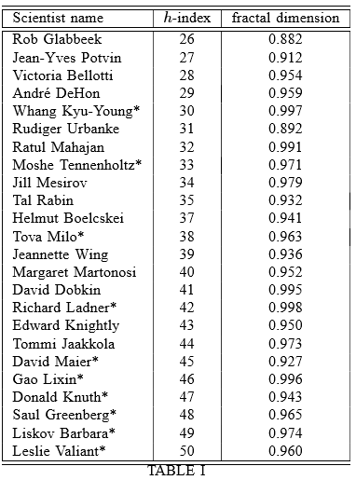
Scientist Ranking (2)
Identified the scientists with the highest fractal dimension values in each distinct h-index value for the range [26,50]
The set contains awarded scientists (asterisk) as well as acknowledged high impact scientists who have not been awarded yet

Slide 17
Merits of the Fractal Dimension
Distinguishes high impact scientists
High fractal dimension value for moderate citation counts (and h-index values) indicates academic potential and may assist peer decisions in award or grant allocation, tenure committees,
High h-index and high fractal dimension constitutes a pattern for increased academic impact and complies with the criteria of peer assessment
Challenge: distinguishing scientists from the most highly populated groups of computer scientists with 15<h<35

Slide 18
Conclusions & Future Work
We introduce single number metric to convey the information expressed by the entire citation curve as a geometric object
Fractal dimension constitutes complementary metric to other indices to represent in a more complete way a scientists’ portfolio
Future challenges include exploring its distinguishing power in different groups, identify the particular qua-lities of scientific impact it focuses on and expand the concept to journals, institutions, publications, etc.

Slide 19

Thank you for your attention!

