Slide 1
Backbones for Internet of Battlefield Things
Dimitrios Papakostas, Theodoros Kasidakis, Evangelia Fragkou, Dimitrios Katsaros
Distributed & Network Algorithmics lab
Department of Electrical & Computer Engineering
University of Thessaly, Greece

Slide 2

Internet of Battlefield Things (IoBT)
IoBΤ: a Cyberphysical System
populated by tens of thousands of “things”:
  humans,
  vehicles,
  unmanned aerial vehicles (UAVs),
  aircrafts,
  sensors, etc.
performing a wide variety of tasks including
  sensing the environment,
  communicating,
  acting in isolation and in cooperation
Video : Collins Aerospace / Connecting the Multi-Domain Battlespace – JADC2 https://www.youtube.com/channel/UC2nODptByABNV_OMyxKCNMQ
Notes:
The Internet of Battlefield Things is a relatively new cyberphysical system populated by tens of thousands of “things”,
such as humans, vehicles, unmanned aerial vehicles (UAVs), aircrafts, sensors, etc. performing a wide variety of tasks
including sensing the environment, communicating, acting in isolation and in cooperation.
Even though it shares a lot of concepts from the Internet of Things and wireless ad hoc networking in general,
a number of challenging characteristics distinguish it and a lot of research is required to address its scale and peculiarities.

Slide 3
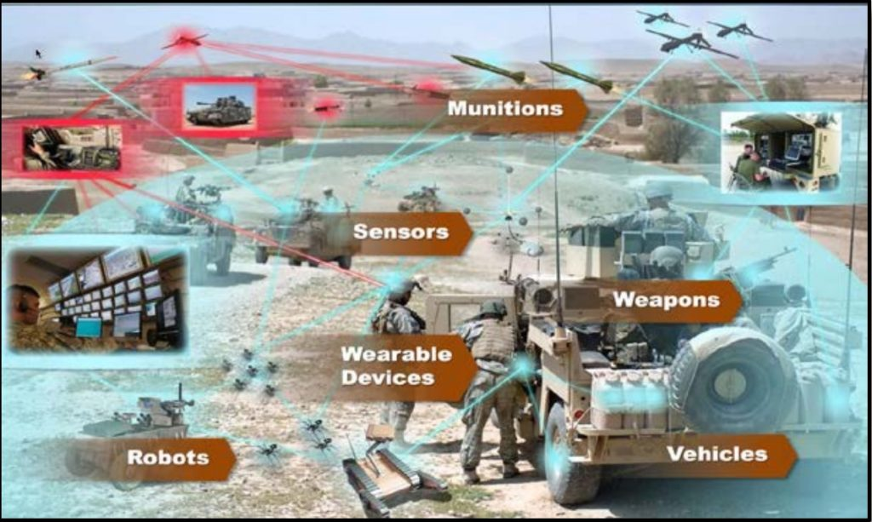
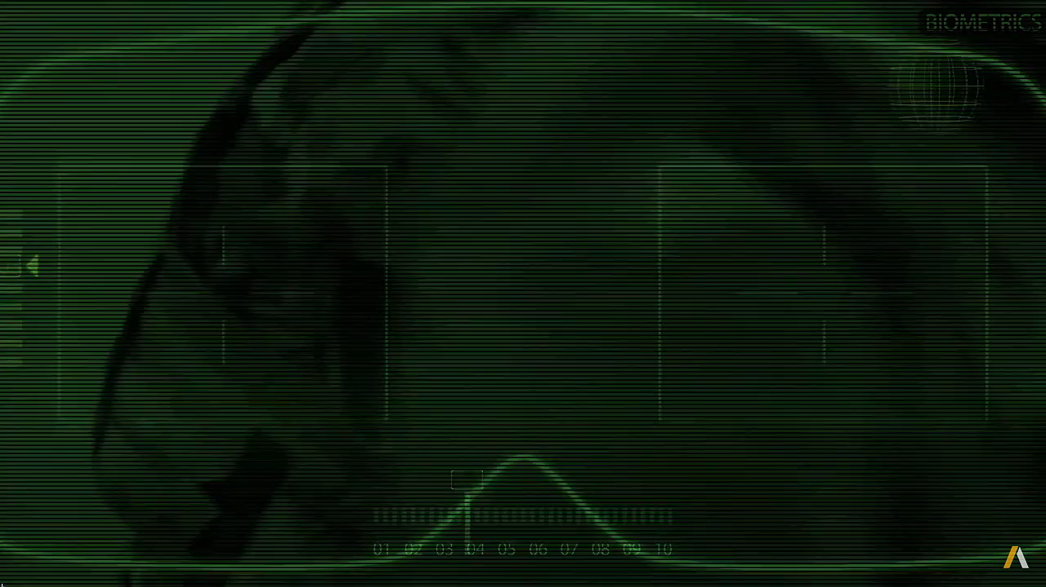
Motivation
IoBΤ compared to traditional IoT
Operation in dynamic and resource starving environments
High variance in network size and density
“Federation” of (sub)networks
Diversity in tasks and goals
Major challenges for IoBT: Assured synthesis
  Recruitment
  [Our focus] Network composition: the issue of dictating the set of nodes that must be included that satisfy the requirements and the constraints of the planned mission, i.e., backbone creation
Video : Collins Aerospace / Connecting the Multi-Domain Battlespace – JADC2 https://www.youtube.com/channel/UC2nODptByABNV_OMyxKCNMQ
Notes:
We briefly describe the most significant features of IoBT below:
----Operation in dynamic and resource starving environments : Some “devices” comprising the IoBT network might be energy-starving such as sensors and drones while others might not have energy issues, but they might be obliged to travel in not well chartered territories (e.g., planes).
----High variance in network size and density: An IoBT might be comprised for instance by the highly dense and cluttered network of a drone swarm, or by the union
of a network formed by the soldiers of a battalion spread over a large area and a network formed by a tank platoon.
----The IoBT network might also be comprised by many subnetworks, resembling a federation and most importantly …
----there might be Diversity in tasks and goals, meaning that there will likely be many networks operating at the same time to achieve their particular goal, e.g., surveillance, tracking, attack. (click)
Thus it is a major challenge for the support of the IoBT network to select a set of strategically positioned nodes in the multilayer network that will assure ubiquitous connectivity and ultimately satisfy the requirements and the constraints of any mission. In our work we do this by constructing a backbone of nodes within the IoBT network.

Slide 4

Modeling an IoBT as a multilayer network
Ad hoc network: Multilayer net
UAVs Layer
Intra-layer
Links
Helicopters Layer
Inter-layer
Links
Soldiers Layers
Tanks Layer
Notes:
In our IoBT context, we model an IoBT ad hoc network as a multilayer network, that is, as a multilayer graph.
A multilayer network comprised of n layers is a pair (G^ML, E^ML),
where G^ML is a set of networks (Gi,Ei), that is, with Gi nodes and Ei links, and E^ML is a set of interlayer
links.
We depict in the slide such a network which is comprised (click)
by a layer of UAVs, a layer of helicopters, two layers of soldiers and a layer of tanks. (click)
The intralayer links are connecting entities of the same layer, (click)
and the interlayer links are connecting entities belonging to different layers.

Slide 5
Problem Formulation
Backbone in the form of (Minimum) Connected Dominating Set (MCDS)
  Solutions for single-layer networks can be far away from optimality and acceptable performance [see Theorem 1, Papakostas in MILCOM’2016]
Formulation
Find MCDS for a multilayer network in a distributed fashion, i.e., Determine the set MCDS^{ML} comprised of the minimum number of nodes (belonging to any layer) such as:
    Their induced subgraph is connected (with intra and/or inter-layer links) and the rest of the nodes are adjacent to at least one node belonging to MCDS^{ML}
    The number of dominators with many interlayer links is maximized
    Knowledge of the k-hop neighborhood of each node [usually, k=2]
D. Papakostas et al., “Backbone formation in military multi-layer ad hoc networks using complex network concepts,” In MILCOM 2016.
Notes:
The most common approach for backbone creation is based on calculating a connected dominating set.
The choice of dominating set concept was made because the battlefield requires
distributed algorithms: even though the calculation of a minimum (in size) CDS is in NP-Complete, there
exist efficient distributed algorithms for this problem,
b) resilient solutions: indeed there is mature knowledge on how to create a multi-connected, multi-dominating CDS,
c) energy-aware solutions (e.g., sleep scheduling): there is also mature theory and practice on how to create e.g.,
multiple dominating sets, i.e., the so-called domatic partitions
Even though there is huge literature on similar topics during the past many years, the problem in military (IoBT) networks
is quite different since these wireless networks are multilayer networks and treating them as a single (flat) network or treating
each layer in isolation and calculating dominating set produces submoptimal or bad solutions; thus all the past literature which
deals with single layer networks is in principle inappropriate
Thus we strive to ….[formulation]

Slide 6
Proposed Algorithms
CCDS - Pseudocode
Learn up to 2-hop neighbor connectivity
Calculate/Broadcast own clPCI index
Store clPCI indexes of 1-hop neighborhood
Sort 1-hop neighborhood in decreasing order of their clPCI index
Progressively select from 1-hop neighborhood and include in the Relay node set the nodes with the largest clPCI index that cover at least one new node in the respective 2-hop neighborhood
Make use of the Restricted Pruning Rule k (k=2) to remove from the Relay node set any nodes that can be substituted by connected nodes with larger clPCI indexes
Notes:
We created two algorithms to solve the MCDS problem for a multilayer network. The first is CCDS and it is distributed and the second is FAST-CMDSM and it is centralized.
I will briefly discuss the way the two algorithms work
CCDS uses the clPCI centrality measure to prioritize the importance of each node within the multilayer network.
Noteworthy, the clPCI is used as a yardstick during the CDS construction phase by each node in order to select their own Relay node set and during the Pruning phase in order to remove from it any redundant nodes.
The slide presents the pseudocode of CCDS

Slide 7
Proposed Algorithms
FAST-CMDSM Pseudocode
Set all nodes as Dominators
Add to DS any nodes that are the only neighbors to other nodes
Progressively set as Dominatee any node that is connected to a Dominator
Add to DS any node not already in it that has only Dominatees in its 1-hop neighborhood
Use Integer Programming to reduce the size of the DS (MDS)
Connect the MDS by covering the 2-hop neighborhood of each node (CDS)
Make use of the Restricted Pruning Rule k (k = network diameter) to remove from the CDS any nodes that can be substituted by connected nodes with larger degree
Notes:
FAST-CMDSM uses Integer Programming to calculate a MDS for the multilayer network which then connects and prunes in order to get smaller CDS. Since it is centralized there is no restriction on how deep it should search in the multilayer topology in order to find redundant paths to remove from the CDS any nodes that can be substituted by connected nodes with larger degree. The slide presents the pseudocode of FAST-CMDSM.

Slide 8
Experimental Evaluation
# Inter – Intra links
Skewness on
  Degree (i.e., hub nodes)
  Distribution of links to layers
  Energy
Datasets
Node energy
Degree
# layers
# nodes
Synthetic only
Real Non existent
Diameter
Notes:
Due to the lack of available, real military networks, we developed a generator for multilayer networks in MATLAB, in order to create in an algorithmic way a variety of multilayer
topologies.
The generator is able to generate topologies where the degree and the energy capacity of a node, the diameter of each layer, the size of each layer, and the number of layers could vary after
defining some parameters.
In our topologies each network layer consists of a set of nodes distributed in a two-dimensional plane by using the unit disk graph model.
In order to better approach reality where obstacles prohibit the direct communication between adjacent nodes, we use non-uniform intra-layer models to distribute the nodes on the two-dimensional plane. Moreover, we use the Zipfian distribution to produce from uniform to highly skewed distributions regarding the number of links a node has towards nodes in different layers, the interconnections towards nodes within a specific layer and the energy capacity of the nodes in the multilayer network.

Slide 9
Experimental Evaluation
Competitors
CCDS
CCDS*
FAST-MDSM
FAST-CMDSM*
FAST-CMDSM
Notes:
We compare the performance of the proposed algorithms, CCDS and FAST-CMDSM. In order to highlight the utility of their pruning heuristics, we include in the comparison their annotated with an asterisk version of those, namely CCDS* and FAST-CMDSM* which concern their respective performance without the use of the pruning heuristic.
Clearly for illustrative purposes, we present also the performance of FAST-MDSM, which constructs Minimum (unconnected) DS, in order to be used as a benchmark regarding the performance of the other competitors; since we have proved in a previous work that any (unconnected) DS of size Kapa can be turned into a CDS by adding 2Kapa additional nodes in the DS in the worst case.
The TABLE depicts the unique characteristics of the competitors.

Slide 10
Experimental Evaluation
Performance measures
Degree
Diameter
Network Size
CDS Size
Min RN Energy
Notes:
The competing algorithms are compared in terms of the size of the CDS they generate. We say an algorithm is more efficient than another algorithm if it generates a smaller CDS.
Additionally, an algorithm that manages to establish per node a relay set with larger minimum residual energy level is considered to be more energy efficient than another algorithm whose per node relay set includes relay nodes with less residual energy.
The table records all the independent parameters we used in our topology generator.

Slide 11
Network Topology Experiments
Network Degree and Diameter
Degree ≥ 6 : Similar performance (<10%)
Degree = 3 : FAST-CMDSM up to 15% better performance
Diameter ≤ 5 : CCDS up to 18% better performance
Diameter = 8, 12 : Similar performance (<10%)
Diameter = 17 : FAST-CMDSM up to 16% better performance
Notes:
Next we present the results of our experiments.
In the left figure we evaluate, per layer, the impact of topology density on the performance of each competitor.
Both CCDS and FAST-CMDSM present similar performance as the topology becomes denser (namely when degree is greater or equal to 6) and both pruning mechanisms work equally well.
When Degree equals to 3 FAST-CMDSM presents up to 15% better performance compared to CCDS. That is due to its centralized nature which allows its pruning mechanism the discovery of any redundant paths that go beyond the 2-hop neighborhood of a node, and thus are not discernible to CCDS.
In the right figure we evaluate, per layer, the effect of the network diameter in the size of the CDS.
Interestingly, when we deal with bushy topologies (namely when diameter <=5) CCDS presents up to 18% better performance compared to FAST-CMDSM which is due to clPCI which outperforms degree, which is used by FAST-CMDSM, in the discovery of strategically situated nodes in the multilayer network.
When diameter equals to 8 or 12 the competitors present similar performance.
Lastly, when diameter equals to 17, FAST-CMDSM outperforms CCDS by 16% which is because of its centralized control which allows for better recognition – selection of the redundant paths when dealing with long and skinny topologies.

Slide 12
Network Topology Experiments
Network Layers Cardinality – Layers size
Layers ≤ 5 : Similar performance (<10%)
Layers = 7 : CCDS up to 14% better performance
Percentage ≤ 30% : CCDS up to 16% better performance
Percentage ≥ 50%: FAST-CMDSM up to 21% better performance
Notes:
Next, in the left figure we evaluate, per layer, the impact of the number of network layers on the performance of each competitor.
We observe that both CCDS and FAST-CMDSM perform equally well when the number of layers is 5 or less. When the layers are 7, then CCDS is
the champion algorithm, as it presents a better performance by 14%, compared to FAST-CMDSM. Those results are consistent to the previous as we have already seen that
both competitors perform equally well in dense topologies, which those under consideration are.
In the right figure we consider, per layer, the impact of increasing the layer size on the performance of each competitor.
We observe that when increasing the size of each subsequent layer by 30% or less then CCDS outperforms FAST-CMDSM up to 16%. That is because in such dense topologies, the
redundant paths remain inside the 2-hop field of view of CCDS and thus its pruning process is more efficient.
However, when increasing the size of each subsequent layer by 50% or more then FAST-CMDSM outperforms
CCDS by up to 21%. That is, because of the large number of interlayer links within the dense multilayer network that render less discernible the redundant paths to CCDS.

Slide 13
Network Energy Experiments
Network Degree / Diameter / Layers Cardinality
Layers : Similar performance (<10%)
Diameter : Similar performance (<10%)
Degree : Similar performance (<10%)
Notes:
Finally, we repeated the majority of the previous experiments by taking into account the energy availability of each network node.
We see in the figure that both CCDS and FAST-CMDSM present similar performance, however, the first selects the most energy efficient CDS in, almost, any case.

Slide 14
Conclusions
Backbones for Internet of Battlefield Things
Backbone for IoBT
CDS to address our target
Distributed CDS calculation
Emphasis on the positioning of the nodes within the multilayer network
Future works
  Unidirectional links extension
  Tiny machine learning in a federated fashion under the IoBT concept
Notes:
The Internet of Battlefield Things is a slowly emerging reality of the well known Internet of Things, but at a significantly larger scale, and with stringent requirements concerning robustness and latency.
In this article, we dealt with the problem of designing a small and resilient backbone for IoBT networks.
We used the modelling strength of multilayer graphs to abstract the real topology of an IoBT network, and adopted the graph theoretic
concept of dominating sets to address our target.
We designed a distributed algorithm, namely the CCDS, for calculating small-cardinality connected dominating sets for such multilayer networks where nodes located in the borders and having connections to different and many layers are preferably selected as members of the dominating set, since they are able to support short communication latency, and significant tolerance to network partitioning attacks.
We evaluated the proposed algorithm performance and it was proved better against its competitors.
Apart from future plans regarding algorithmic aspects and extensions of the proposed solution to unidirectional links,
our future work includes the application of tiny machine learning in a federated fashion to other aspects of IoBT such as
developing sophisticated distributed deep learning algorithms for heterogeneous learning nodes.

