Slide 1
Blocking Epidemic Propagation in Vehicular Networks
Pavlos Basaras, Ioannis Belikaidis, Leandros Maglaras, Dimitrios Katsaros
University of Thessaly, Greece

Slide 2
VANET in 3 words: Moving & Sensing & Sharing

Slide 3
Applications
Safety applications…
Overall: To name just a few...
Increase road safety
Improve traffic efficiency
Reduction of CO2 emissions
Data sharing and infotainment

Slide 4
Infected Vehicles?
Vehicles are evolving into mobile computing engines equipped with modern devices to satisfy our ever increasing “needs”
Advanced On-Board-Units for communication
Internet and cloud access
Or even remote control
However
What if vehicles can be attacked, i.e., infected with malware
If your car is infected, then, anything that the infected computer is responsible for, is infected

Slide 5
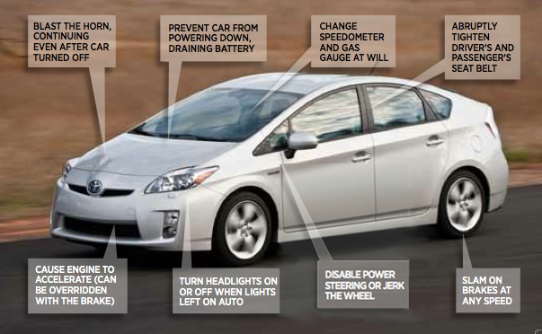
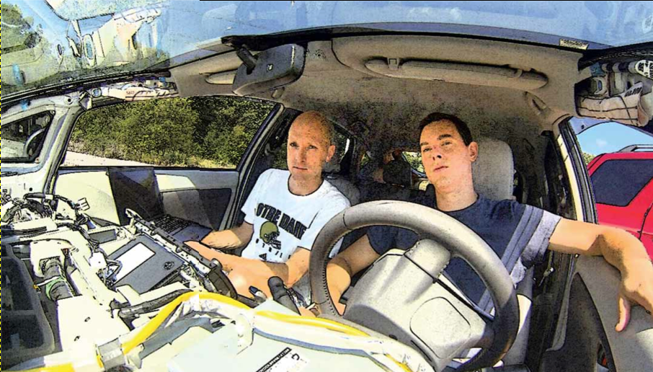
Carjacking cases: Ford Escape & Toyota Prius
Charlie Miller and Chris Valasek attack (with just a laptop connected to the car’s diagnostics port)
http://www.forbes.com/sites/andygreenberg/2013/07/24/hackers-reveal-nasty-new-car-attacks-with-me-behind-the-wheel-video/#5daf8c025bf2
disabled the brakes, honked the horn, jerked the seat belt, and commandeered the steering wheel

Slide 6
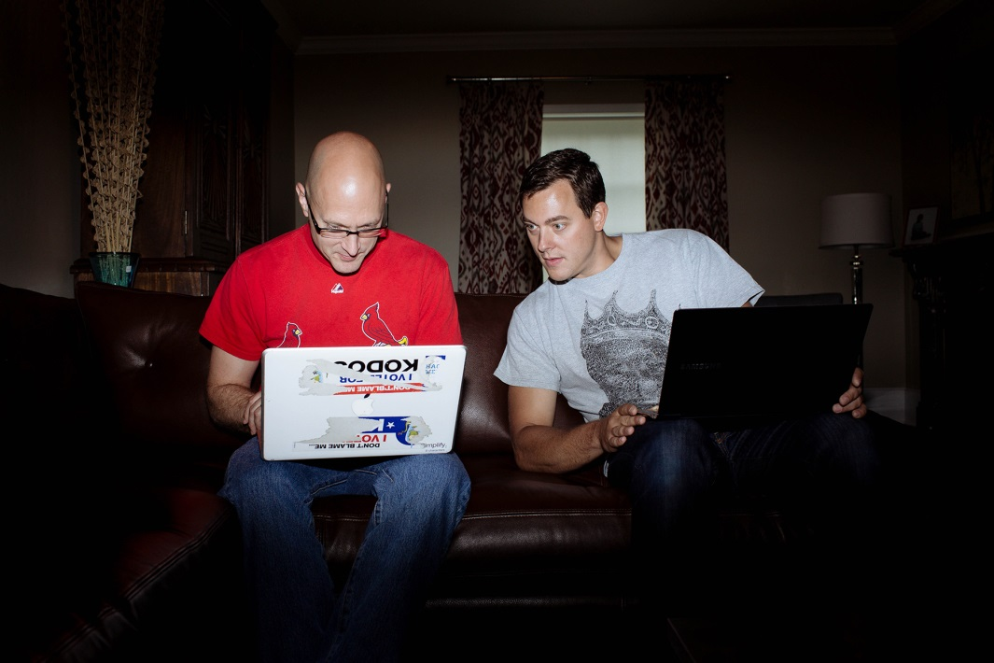
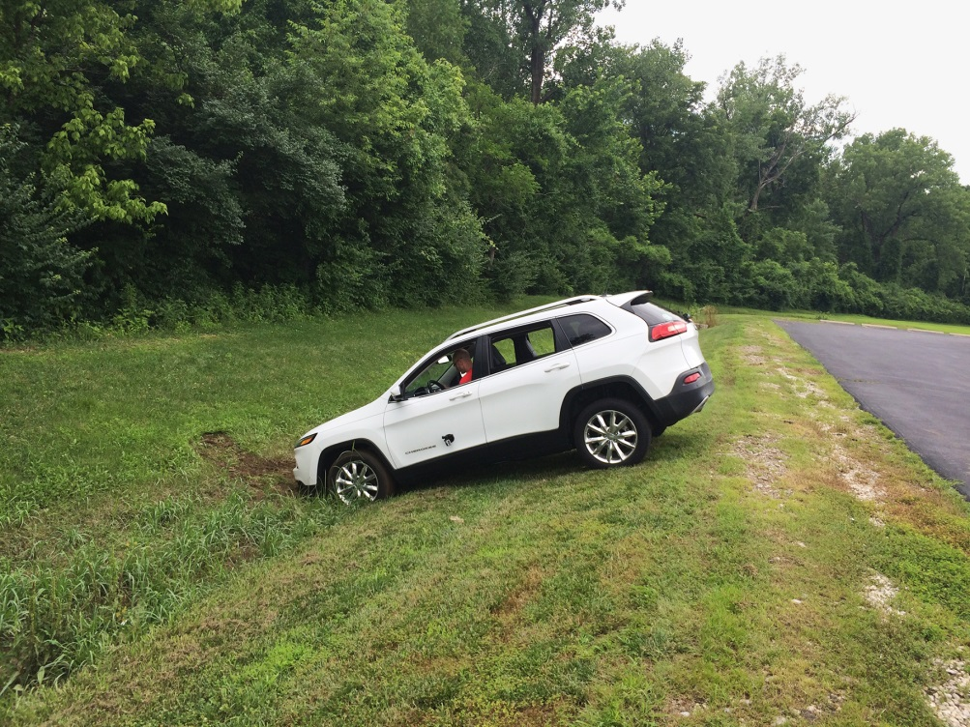
Carjacking cases: Jeep Cherokee
Charlie Miller and Chris Valasek (wirelessly) attack a Cherokee
http://www.wired.com/2015/07/hackers-remotely-kill-jeep-highway/
the vents in the Jeep Cherokee started blasting cold air at the maximum setting, chilling the sweat on my back through the in-seat climate control system. Next the radio switched to the local hip hop station and began blaring Skee-lo at full volume. I spun the control knob left and hit the power button, to no avail. Then the windshield wipers turned on, and wiper fluid blurred the glass
zero-day exploit
software that lets hackers send commands through the Jeep’s entertainment system to its dashboard functions, steering, brakes, and transmission, all from a laptop that may be across the country

Slide 7
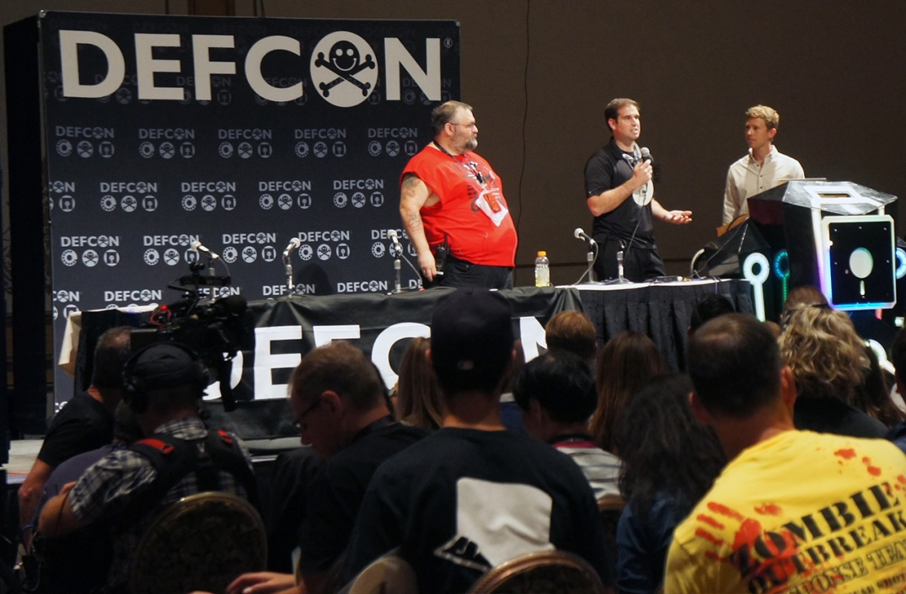
Carjacking cases: Tesla model S
Kevin Mahaffey (co-founder and CTO of security firm Lookout ) and Marc Rogers (principal security researcher for CloudFlare)
http://www.wired.com/2015/08/researchers-hacked-model-s-teslas-already/
Found six vulnerabilities in the car’s systems
Security holes allowed a criminal take a PC, physically connect it to the Ethernet network inside of a car and use a software command to dash away. Alternatively, malefactors could infect the system with a Trojan, which would let them cut an engine remotely, with a person driving the car

Slide 8
What can we do? (use cases)
If the malware is ‘known’, then a patch can be downloaded and installed, e.g., via 4G communication, and thus cure the vehicle
However if the virus is novel, a questionable amount of time may pass until an appropriate patch is ready for dispatching
Moreover there are cases so severe which require physical interference to remove infection, e.g., the tesla case
Notes:
If even if a cellular network is provided for delivering patches, the density of infected vehicles in a region may prove to be a challenging environment for the base station
For the last bullet reference[30] from the paper, i.e., the tesla car

Slide 9
A complex network approach (intuition)
We may not be able (currently) to ‘heal’ an infected vehicle, we can however inform the rest of the vehicular network for its presence
Vehicles informed of infected vehicle ids will shut communication with those vehicles
Intuition: complex networks literature: competing memes propagation on networks, i.e., the meme which reaches more nodes, i.e., vehicles, wins!
Notes:
First meme: the virus
Second meme: the infected vehicle ids

Slide 10
Separating Disinfection from Epidemic Blocking (prerequisites)
Specialized Hardware (SH): a stationary scanner, able to detect infection upon vehicles
Highly secure devices
However: Limited scanning range
Vehicles are not entrusted with functionality similar to that of an SH
Notes:
Last bullet: Reference 30 in the paper

Slide 11
Proposed Mechanism(1/3)
Infected vehicles are included in a black list (BL)
SHs periodically broadcasts the BL to vehicles within range
SHs communicate
Susceptible vehicles will further spread the received BL to other vehicles in their path/range
Notes:
isolated areas, i.e., areas relatively far from any SH may yet be protected, if an informed vehicle traverses the area
SHs can communicate, e.g., via internet, and broadcast a cumulative BL, as identified by all SH

Slide 12
Proposed Mechanism(2/3)
A portion of the vicinity of each newly detected vehicle is included in a second list, namely, Potentially Infected Vehicles (PIV) list
What portion?
All or Ηalf
Which vehicles?
Time or Degree
PIV is broadcasted from the SH (and later by S vehicles) similarly to BL
Notes:
When in range of an SH a vehicle is prompted to send its current neighbor list
Moreover, unlike static networks where the number of deletions is limited [8] [36], in a VANET nodes can be deleted in a broadcast fashion. Hence we choose to cut either all or half of the neighborhood of an infected source

Slide 13
Proposed Mechanism(3/3)
Vehicles will remain in PIV until their next encounter with an SH
Upon scanning a vehicle in PIV:
If found susceptible, the vehicle’s communication is restored
Else, the vehicle id moves to the BL, its neighbors in PIV and so on..
Notes:
Restoring vehicles from PIV: upon entering the SH a susceptible vehicle compares its PIV with that of the SH. If a vehicle is included in the vehicle’s PIV but not in the SHs it means that the vehicle was scanned and found susceptible. Hence the vehicle updates its list, and upon encountering other susceptible vehicles, the PIV with the most recent timestamp is maintained in each respective vicinity.

Slide 14
Overview
Detecting Infection
Exchanging PIV and BL lists
Notes:
Since multiple versions of the BL or PIV may be carried by vehicles with respect to their last encounter with an SH, susceptible vehicles will exchange their version of both BL and PIV, and hence increase the awareness of the vicinity for the infected sources.

Slide 15
Virus Propagation
SIR spreading model
Susceptible: a vehicle that can get infected
Infectious: a vehicle carrying the virus, trying to infect any vehicle it encounters
Recovered: a vehicle immune to the ‘current/specific’ virus
Infection delay (τ): number of transmissions needed for a susceptible vehicle to become infected
Virus Strength: number of vehicles in the simulation vulnerable to infection
Notes:
Infection delay (τ): It indicates the number of transmissions needed for a susceptible vehicle to become infected when in contact with an infected source. It is a virus specific parameter characterizing the strength of the virus which may depend on the length of the worm code or the way it is hidden within the exchanged messages.
Virus Strength: it is reasonable to assume that a virus may not be able to ”penetrate the defenses” of all vehicles it encounters [11]. This may be due to manufacturing aspects, antivirus flaws, etc., Hence it indicates the percentage of vehicles vulnerable to infection

Slide 16
Simulation Setup
Simulators:
SUMO: most popular and well established road traffic simulator
OMNET++: an event based network simulator
VEINS: combines SUMO & OMNET++ for the vehicular simulation

Slide 17
Simulation Map
Randomly generated routes
Infection is initiated by a single vehicle
Different initial spreading points: A, B, C, etc.
Infections starts at 100s
Total simulation time: 500s
Results were averaged over 10 independent runs per point

Slide 18
Simulation Parameters
Parameters | Range | Default
Infection Delay (τ) | 1 - 6 | 4
Vehicle Speed (m/s) | 8 - 14 | Uniform
Vehicle Density (per Hour) | 1000 - 2500 | 1500
SH Scan Range (m) | 30 | 30
Included in PIV(%) | 50 - 100 | 100
Vehicle Transmission Range (m) | 300 | 300
Virus Strength (%) | 25 - 100 | 100
Notes:
The transmission range of the SH is kept low (for both scanning vehicles and informing susceptible nodes) in order to highlight the effectiveness of the proposed mechanism and not due to the wide range of the SH.

Slide 19
Vehicle Density & Different Initial Spreader
Notes:
Default values

Slide 20
Infected Vehicle Nodes
Notes:
Default values,
This plot is the same with the previous one, but in averages per density

Slide 21
Impact of Infection Delay
Notes:
Default values

Slide 22
Impact of Virus Strength
Notes:
Default values

Slide 23
Impact of Different Cut Methods
Notes:
50% of an infected node’s neighbors is included in PIV based on contact duration and degree, rest default

Slide 24
Conclusion
We separate the task of infection blocking from the task of disinfection
The framework of competing memes over VANETS showed interesting results
Directions
more sophisticated malware, which may include cooperation among infected vehicles
more sophisticated methods for PIV list

Slide 25
Questions

Slide 26
Different Areas in the map
Area 1: mostly allows spreading in a vertical or horizontal fashion
Area 2: horizontal transmissions are often blocked
Area 3 or around the area of SH1, transmissions occur in all possible directions (horizontal, vertical, diagonal, etc.) due to the existence of large open areas, i.e., sparser buildings locations, providing a more favorable environ for the virus to propagate faster with respect to the other areas.

